Slide 1

Montana Counselor Update Fall 2023

Slide 2

???????

Slide 3
New Terms and Acronyms
SAI=Student Aid Index (replaces the EFC)
FTI=Federal Tax Information
FUTURE Act Direct Data Exchange (FADDX) (replaces DRT)
FAFSA ® Contributors -Parent, Other Parent, Student Spouse, and Student (when invited by Parent or Preparer)
Enrollment Intensity- Enrollment intensity is the percentage of full-time enrollment at which a student is enrolled, rounded to the nearest whole percent.

Slide 4
FEDERAL STUDENT AID ID (FSA ID)
An FSA ID is a username and password that gives a student/parent access to Federal Student Aid’s online systems and serves as their legal signature.
FAFSA Contributors will need their own individual FSA IDs.
The FSA ID will have a 2 step verification.
With the new 2024-25 FAFSA it will be necessary to complete the FSA ID at least3 days before the FAFSA https://studentaid.gov/fsa-id/create-account/personal-info
FSA ID requires an email address or mobile phone number. An email address and mobile number can only be associated with one FSAID. Parents and students cannot use the same email or mobile phone number.
Students should not use a high school email address because it will be deleted after graduation.

Slide 5
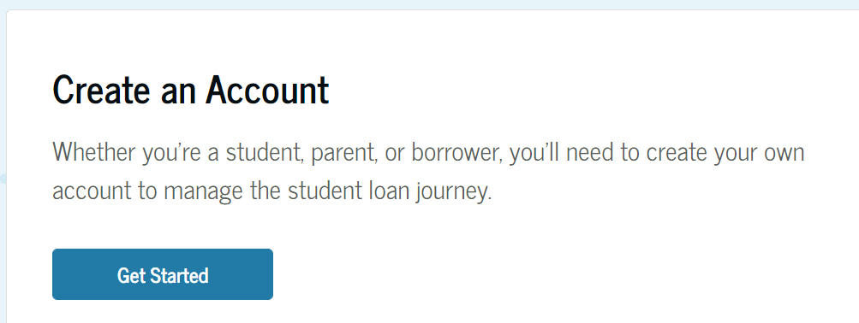
Create an FSA ID https://studentaid.gov/fsa-id/create-account/personal-info
  Contributors without a social security number are asked to provide their Individual Taxpayer Identification Number (ITIN)

Slide 6
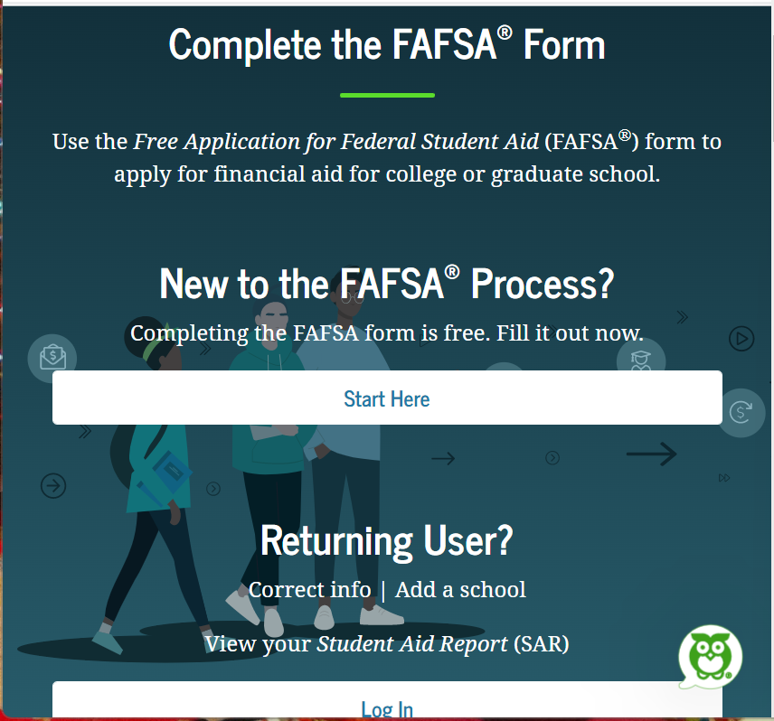
Completing the FAFSA
Make sure all contributors already have a confirmed FSA ID
Start here https://studentaid.gov/h/apply-for-aid/fafsa

Slide 7
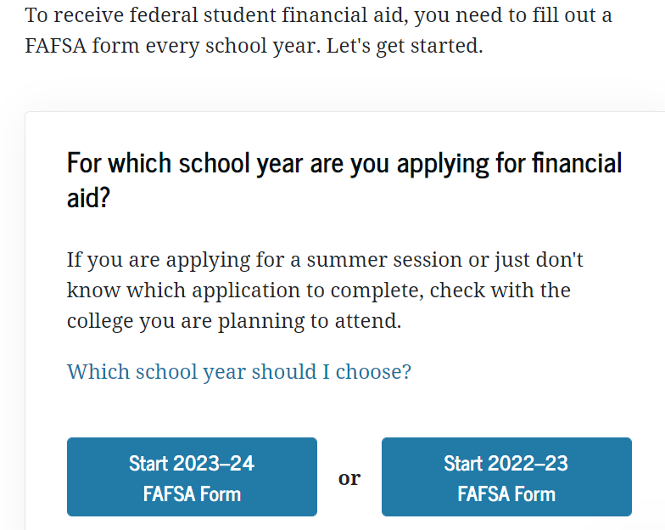
Select the correct year (2024-2025 for Fall 2024)

Slide 8
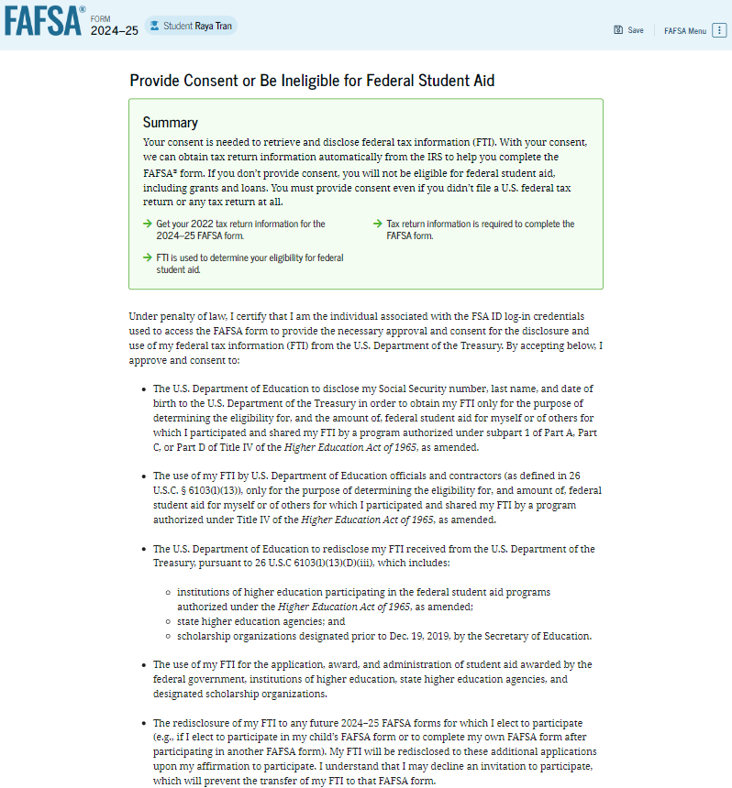
https://studentaid.gov/h/apply-for-aid/fafsa
First time in the 2024-25 FAFSA ® Form there will be an onboarding page with Video. (4 pages)
Consent page- will need to consent for the FTI (federal tax information) to be transferred in. If the student/ parent does not consent they are not eligible for Title IV aid. They will have an option to complete information manually.
Inviting the parents/spouse

Slide 9
Which Parent?
Dependent Students will be asked to provide information regarding their parent(s)
The student will be prompted to invite the parents to complete the parent financials.
Divorced Parent
Parent who provides more support. Not who they live with.
IF they share support 50/50 the parent with the greater income will provide their info on the FAFSA.
NEW PARENT WIZARD

Slide 10
Inviting the Parent/Spouse

Slide 11
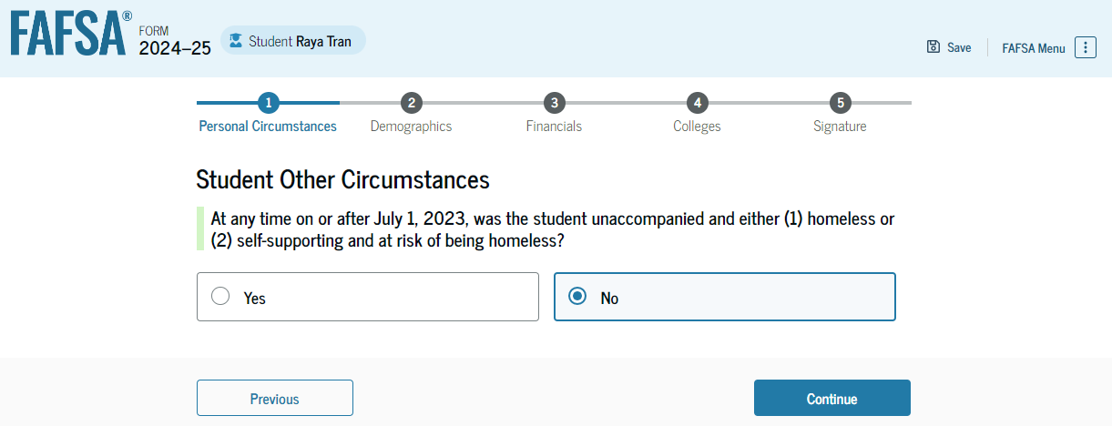
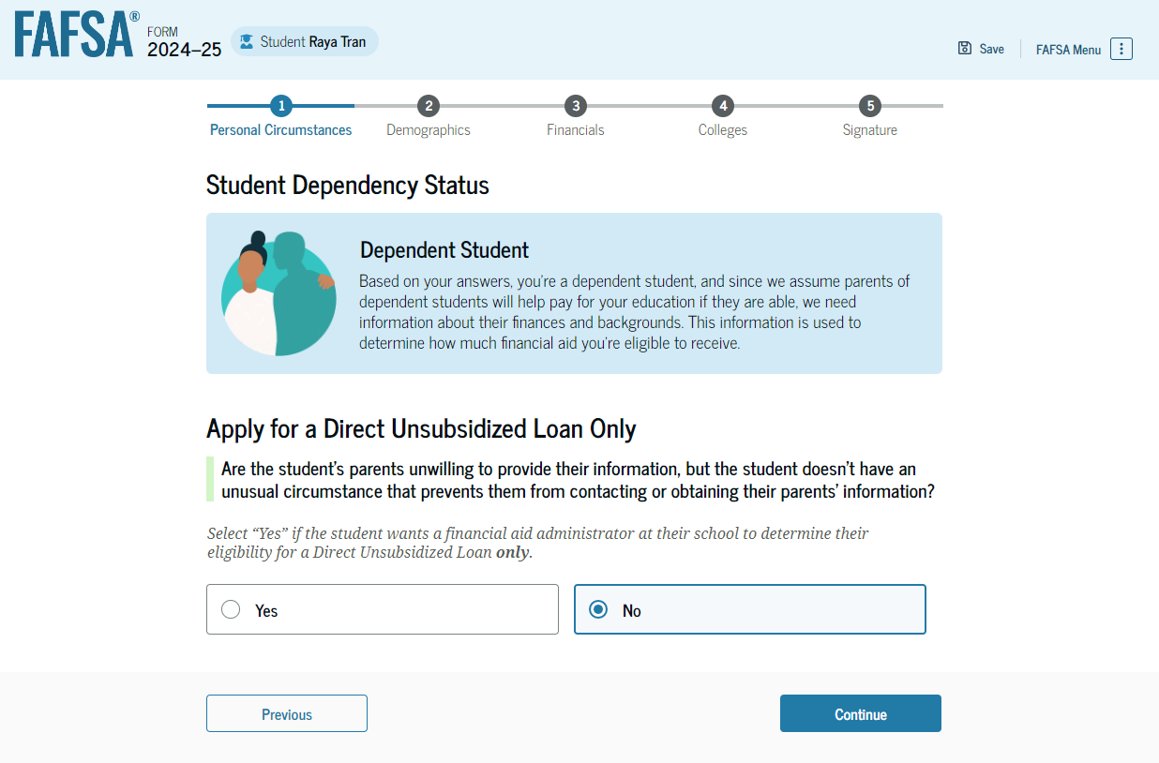
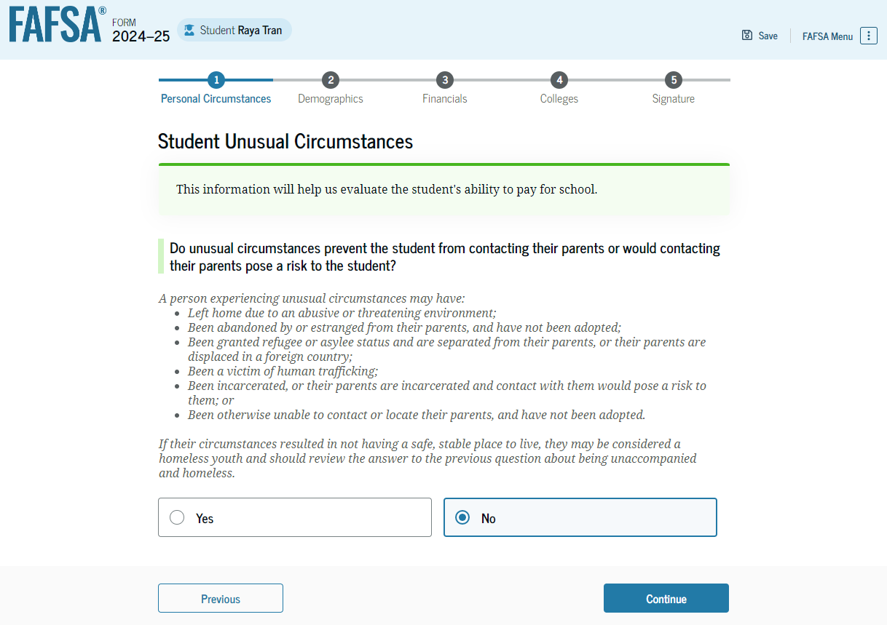
Student Other circumstances
Student will be asked about Homelessness.
If the parent just refuses to complete the FAFSA the student can select yes at this point and apply for Unsubsidized Loans Only.
or Unusual Circumstance that prevent them from contacting their parent(s). (Dependent students only)

Slide 12
FAFSA Changes
  Family size instead of Household size:
  The Family Size will be based on the number of dependents on the Taxes.
    Can be self reported
  Asset information:
  Value of family farms and small businesses will no longer be excluded from assets (if family is required to report assets.
  Net worth is value of business or farm minus any debts owed against it. Will need to list fair market value of land, livestock, crops.
  Annual child support received. Reported in the Calendar year.
  Cash, savings, checking, time deposits and money market funds.
  Net worth of investments, including real estate (excluding primary residence).
  Adjusted net worth of business and/or farm. Excluding primary residence.
  Asset protection allowance.

Slide 13
FAFSA Changes
  INDEPENDENT STUDENTS AND PARENT INFO
  Department cannot collect parent information from independent students starting with the 2024–25 award year
  Schools that use parent information for health professions programs or institutional aid programs will need to find a new method

Slide 14
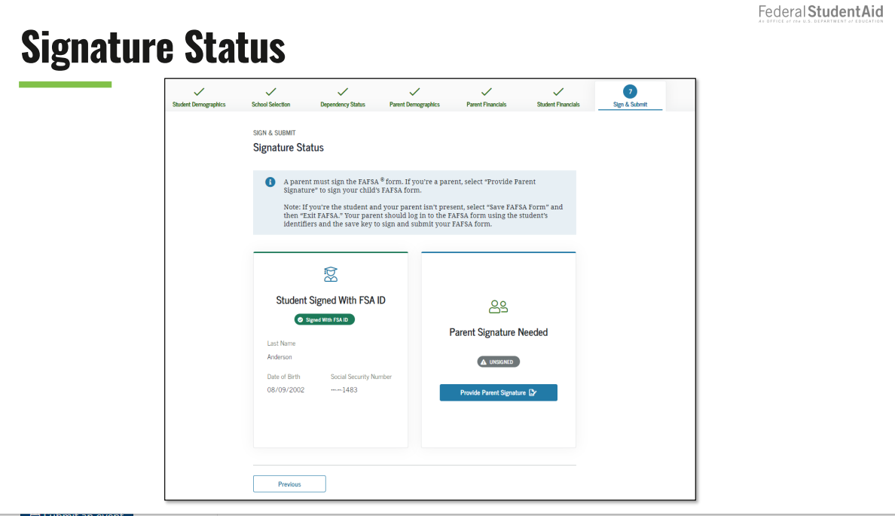
Student & Parent are able to complete and sign the FAFSA at the same time

Slide 15
VERIFICATION
2024-2025
Three Categories
V1 – Standard Verification Group – Items that must be Verified
TAX FILERS
  Adjusted Gross Income
  US Income Tax Paid
  Untaxed Portions of IRA Distributions & Pensions
  IRA Deductions & Payments
  Tax Exempt Interest Income
  Education Credits
  Non-Tax Filers
  *Income Earned from Work
  Tax Filers & Non-Tax Filer
    Number in Household & Number in College

Slide 16
V4 Custom Verification Group
Identity/Statement of Educational Purposes
  College will provide a document for the student to verify that they will use any Education Funds for Educational Expenses &
  College will verify a picture ID of the student
  If student is unable to come to the Financial Aid Office, student can use a Notary to verify items above and submit clear copies to the office

Slide 17
V5 Aggregate Verification Group
All items listed in V1 & V4 Category
If students & parents import their IRS Tax Information through the IRS Data Retrieval Tool (DRT), most likely they will not have to submit any tax documents

Slide 18

EXAMPLES OF SPECIAL CIRCUMSTANCES
Loss of Child Support
Unusual uncovered medical/dental expenses
Extraordinary dependent care
Parent or spouse death
Loss of employment
Divorce

Slide 19

QUESTIONS?

